Slide 1
Introduction to UNIX
Karl Harrison
September 2004

Slide 2
The UNIX Operating System
An operating system (or "OS") is a set of programs that controls a computer
It controls both the
  hardware (things you can touch—such as keyboards, displays, and disk drives)
  software (application programs that you run, such as a word processor).

Slide 3
The UNIX Operating System
Some computers have a single-user OS, which means only one person can use the computer at a time. They can also do only one job at a time.
But if it has a multiuser, multitasking operating system like UNIX. Then these powerful OSes can let many people use the computer at the same time and let each user run several jobs at once.

Slide 4
Versions of UNIX
Now there are many different versions of UNIX.
At first there were two main versions:
  The line of UNIX releases that started at AT&T (the latest is System V Release 4),
  And from the University of California at Berkeley (the latest version is BSD 4.4).

Slide 5
Versions of UNIX
Now commercial versions include SunOS, Solaris, SCO UNIX, SG IRIX, AIX, HP/UX
The freely available versions include Linux and FreeBSD 5.2 (based on 4.4BSD)
  Many Versions of Linux - Redhat, Fedroa, Debian, SuSE and MandrakeSoft
Apple Mac OS X (FreeBSD 5.2)

Slide 6
What is different with UNIX
Services
GUI
User Applications
Hardware
UNIX Kernel
Commands & Shell
X Windows
Other Users

Slide 7

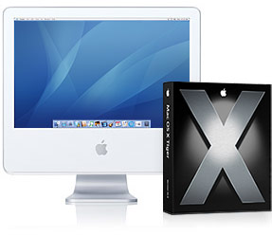
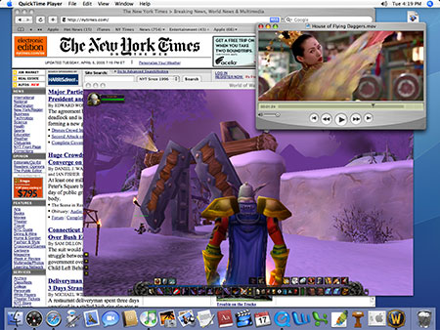
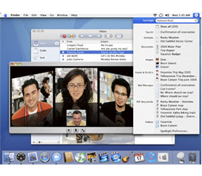
UNIX GUI’s -Apple OS X 10.4

Slide 8
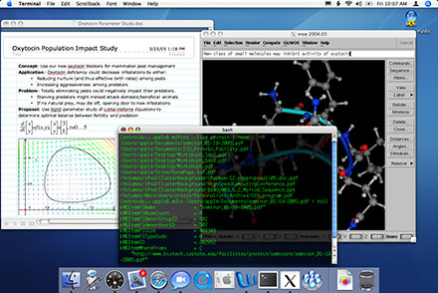
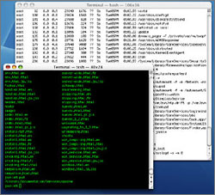
UNIX GUI’s -Apple OS X 10.4

Slide 9
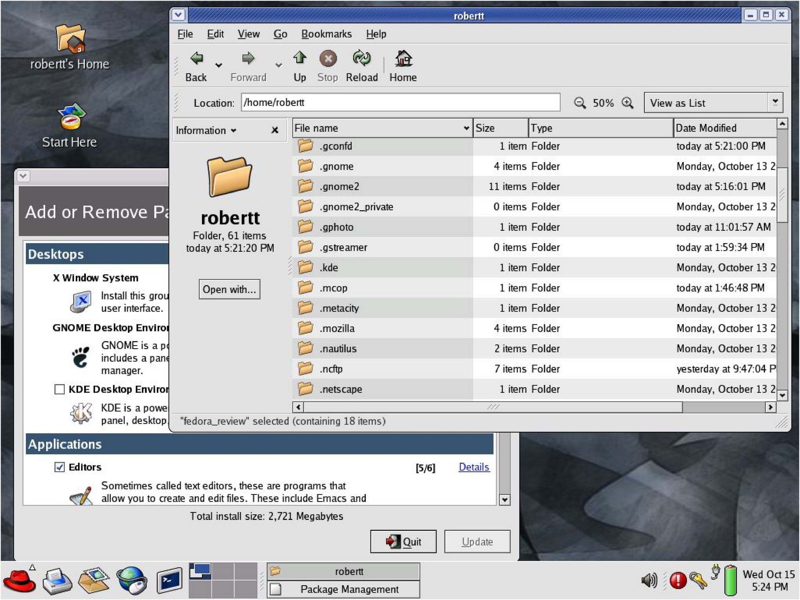
UNIX GUI’s -Fedora KDE

Slide 10
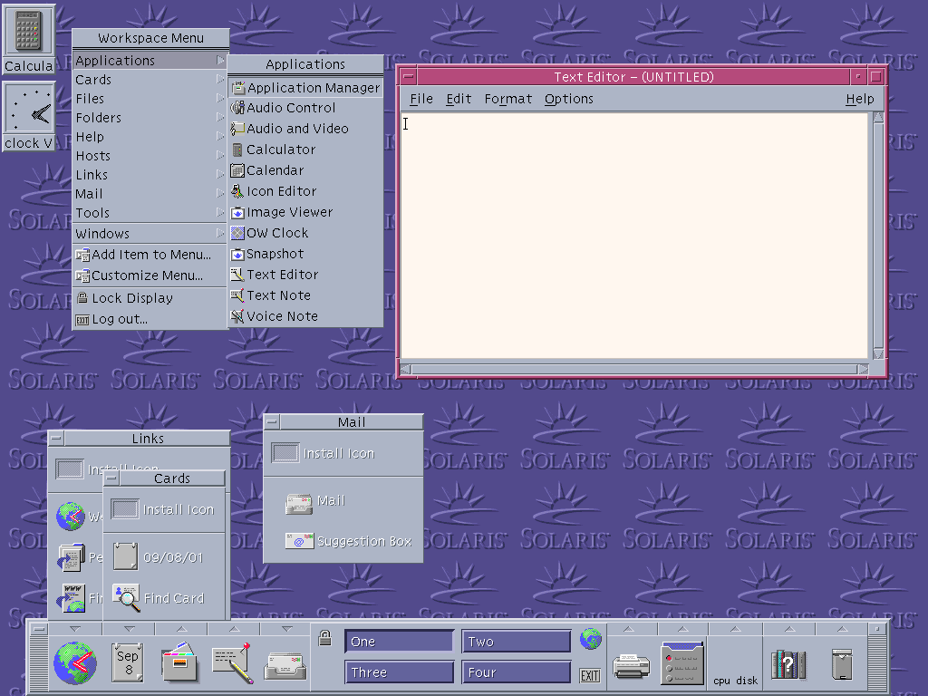
UNIX GUI’s -Solaris

Slide 11
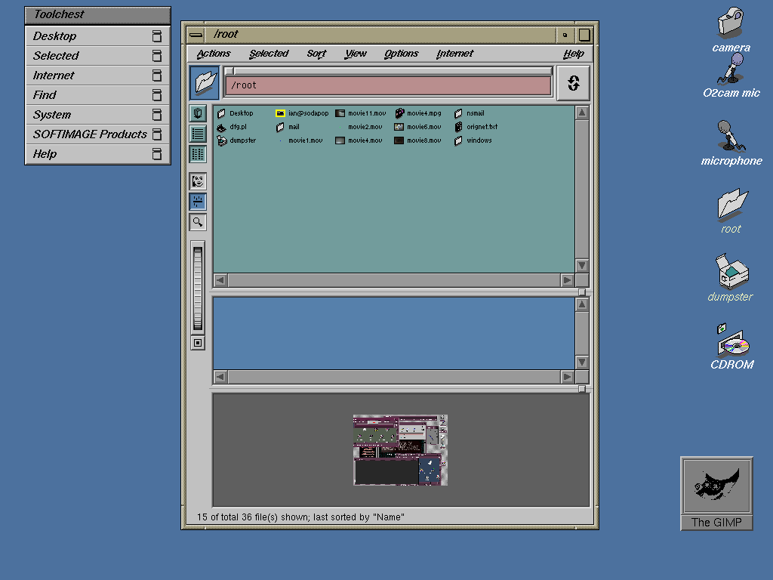
UNIX GUI’s -SG IRIX

Slide 12
Remote UNIX log on

Slide 13
Oxford UNIX System
OUCS provides a general-purpose cluster of computers running Debian GNU/Linux.
The service is available to any University member who has a Herald account, and is accessed using Herald username and password on secure login to linux.ox.ac.uk.
  http://www.oucs.ox.ac.uk/services/linux/

Slide 14
UNIX Tutorials
Maui High Performance Computing Centre
  http://www.mhpcc.edu/training/vitecbids/UnixIntro/UnixIntro.html
  Also
  http://www.chem.ox.ac.uk/course/unix/unix.html
Vi Editor
  http://www.eng.hawaii.edu/Tutor/vi.html

